Slide 1
AAE 625 Agribusiness Economics & Management
Slides prepared for the 1st week of AAE 625 Agribusiness Economics & Management
Jing Yi, PhD
Department of Agricultural & Applied Economics (AAE)
University of Wisconsin - Madison
Jing Yi, Faculty Associate, Department of Agricultural & Applied Economics (AAE), jing.yi@wisc.edu

Slide 2
Agenda for Week 1
I. Tuesday:
My Background
Getting to Know You
Syllabus Overview
Class Preparation:
Github
Python
II. Thursday (No Class)
Homework 1 to set up the environment for this course.

Slide 3
My Professional Journey

Slide 4
My Professional Journey
Professional Journey
Faculty Associate at UW–Madison
Former Faculty Research Associate at Cornell University
Former Research Assistant at the Agricultural Food and Policy Center
(AFPC), Texas A&M University
Teaching: Agricultural Finance, Agricultural Business, Credit and Banking,
World Hunger and Malnutrition, Machine Learning
Research: Risk Management, Farm Financial Management, Consumer Demand
Analysis, Policy Analysis, Food Systems, Natural Resources
Awards:
Top Downloaded Paper Award, Journal of Risk and Insurance
Top Cited Article Award, Journal of Risk and Insurance
Outstanding Research Award, AAEA
Goal: Providing actionable insights that empower producers and policymakers to
navigate complex challenges effectively.

Slide 5
Getting to Know You
What’s your name?
What’s your major?
What do you hope to gain from this class?

Slide 6
Syllabus Overview

Slide 7
Syllabus

Slide 8
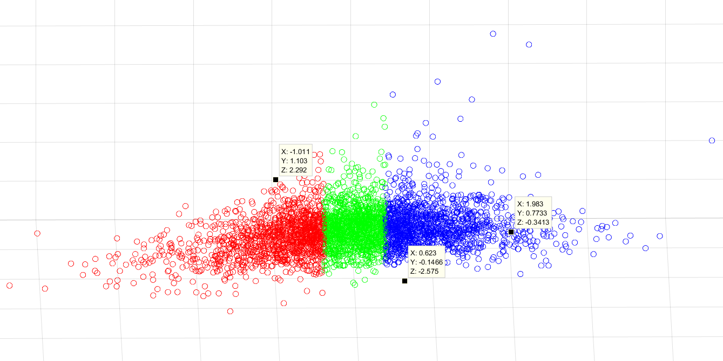

Ratio Analysis
Net dairy income per hundredweight (NDI):
Net income per unit of milk production
Profitability of producing milk per unit
Return on equity (ROE)
Net farm income before interests/equity
Profitability of using equity
Asset turnover ratio (ATR)
Ability of converting assets into revenue
Efficiency of asset management
Lowest net farm income
Highest asset turnover ratio
Highest net farm income
Low asset turnover ratio
Yi, Jing, and Jennifer Ifft. "Labor-use efficiency and New York dairy farm financial performance." Agricultural Finance Review 79, no. 5 (2019): 646-665.

Slide 9
Recommended Textbook
Agribusiness Management (6th edition)
Introduction to Agricultural Economics (7th edition)
Managerial Economics: Theory, Applications and Cases (8th edition).

Slide 10
Class Preparation
EXCEL
Python
Example
Anaconda
VS Code
GitHub
Enterprise, Private
Website
SQL
Tableau
Installation: https://data.wisc.edu/tableau/

Slide 11
Class Preparation
Install Excel

Slide 12
Class Preparation: GitHub
A web-based platform for version control and collaboration.
Hosts code repositories and tracks changes.
Example (Please note that you won’t be able to view these private pages on your computer)
https://github.coecis.cornell.edu/jy348/LaborAFVC
https://github.com/fedscornell/AAE625_25

Slide 13
GitHub: Personal Accounts vs Enterprise Accounts
Personal GitHub Accounts:
Typically used by individual developers for personal projects.
Offers public and private repositories.
Limited access to advanced GitHub features like team management or compliance tools.
GitHub Enterprise Accounts:
Designed for businesses and large organizations.
Includes advanced security features like SAML single sign-on, LDAP, and IP allow lists.
Provides organizational tools for managing multiple users, teams, and r

Slide 14
What is a GitHub Repository?
Think of it as a folder for your project.
Example: Personal Account; Enterprise Account
Stores your project files: code, documentation, etc.
Keeps track of every change you and your team make.
Can be public (anyone can see it) or private (restricted to certain
users).
Perfect for collaboration: multiple people can work on the same
project.

Slide 15
GitHub: Web Interface vs Desktop Application
GitHub Web Interface (GitHub.com):
Accessible via the GitHub website (github.com).
Centralized hosting for repositories, available to users and teams worldwide.
Allows you to view, create, and manage repositories.
Supports collaboration through pull requests, issues, and discussions.
Provides tools for project management (e.g., Kanban boards, milestones).
Integrates with CI/CD tools like GitHub Actions for automating workflows.
Offers insights, statistics, and reporting features for repositories.
GitHub Desktop Application (Local Development):
Involves using Git or GitHub Desktop app on your local machine.
Enables local development with Git repositories cloned from GitHub.
Supports offline workchanges can be committed locally and pushed to the remote when online.
GitHub Desktop provides a GUI for interacting with repositories, managing commits, branches,
and pull requests.
Allows for faster code writing, testing, and debugging locally.

Slide 16
Apply for Your GitHub Education Account
https://canvas.wisc.edu/courses/450492/files/43803016?module_item_id=8215053

Slide 17
Install GitHub Desktop
Download and install GitHub desktop:
https://desktop.github.com/download/

Slide 18
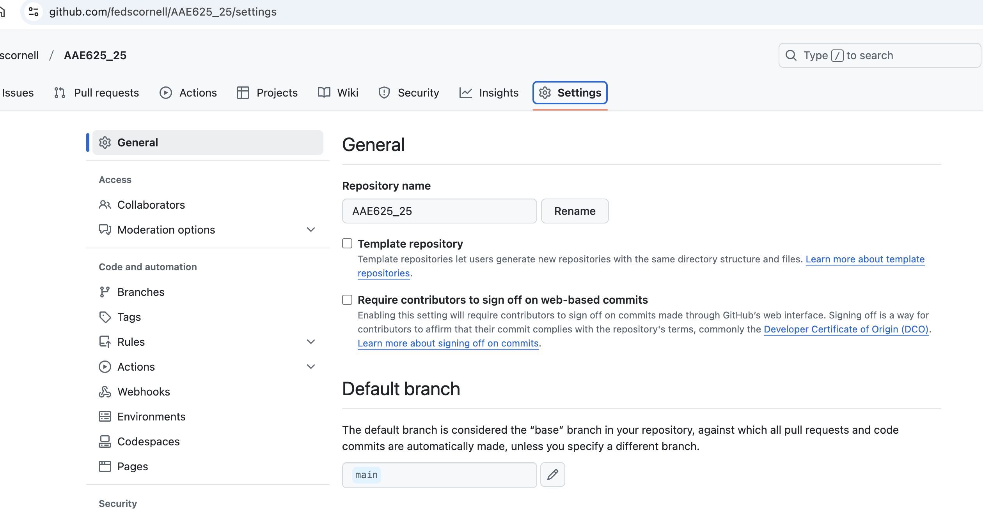
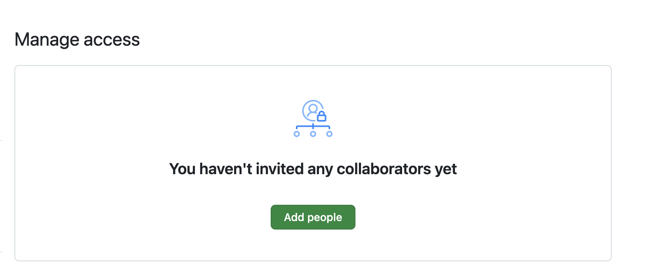
GitHub - Add Collaborators:
Add jing.yi@wisc.edu as your collaborator

Slide 19
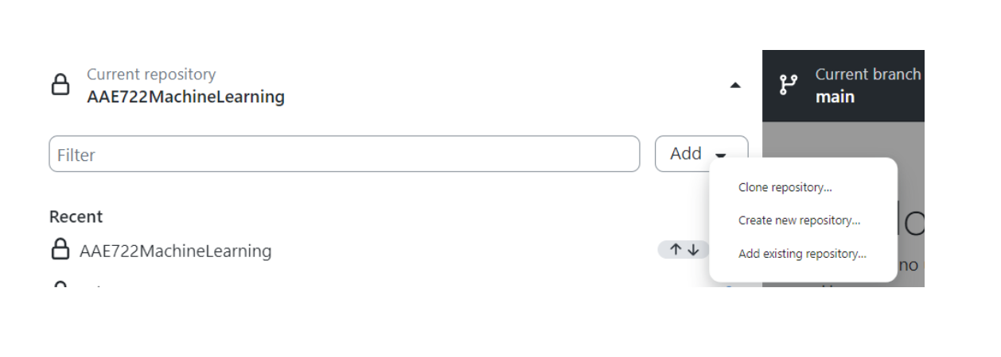
Clone A Repository
Clone this course repository to your computer:
https://github.com/fedscornell/AAE625_25.git
website: https://github.com/fedscornell/AAE625_25

Slide 20
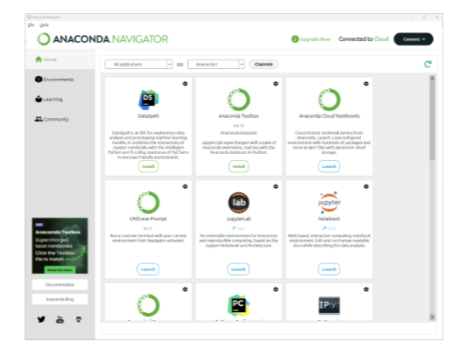
Install Python:
Download Anaconda for Python:
https://www.anaconda.com/products/individual
Anaconda is a package manager for Python. It installs:
The Python 3 programming language
VS Codd:
A user-friendly integrated development environment (IDE).
It allows you to write and run code as well as take notes about the code in the same place.
Check all the boxes during the installation.
The installation will take several minutes to complete.

Slide 21
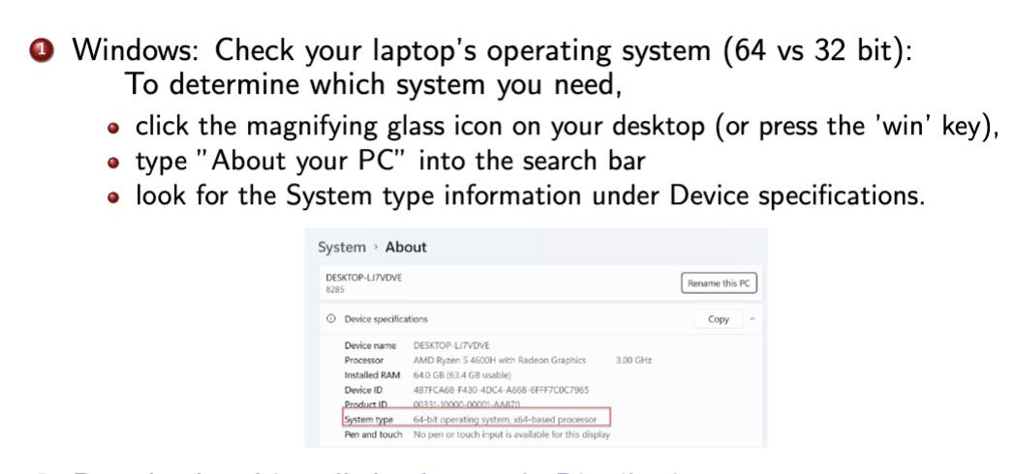
Check the Operating System of Your Laptop

Slide 22
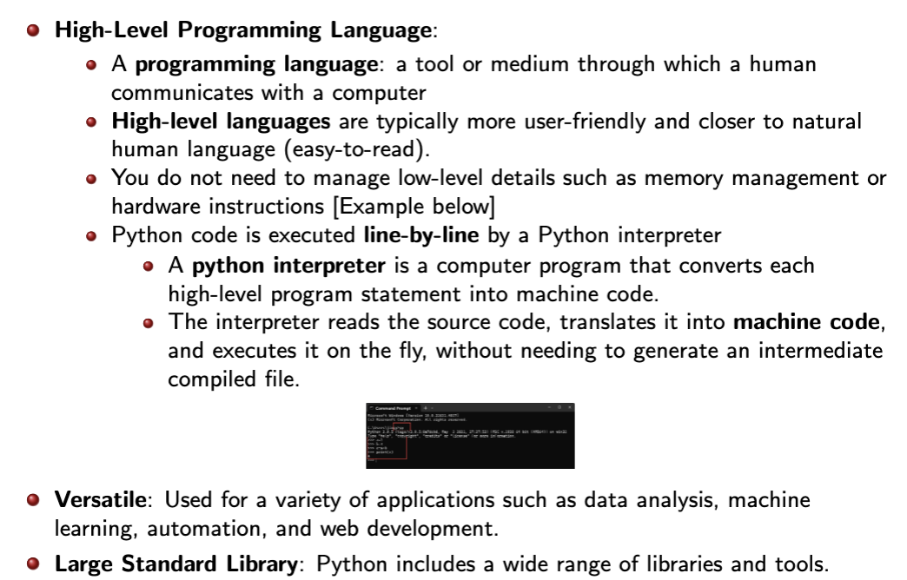
Python Overview

Slide 23
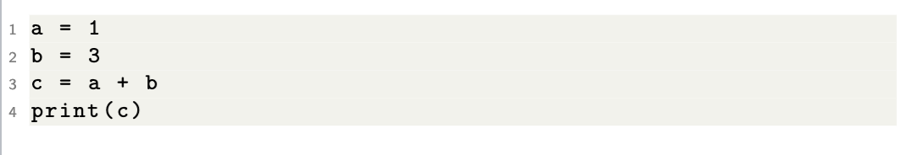
High-level VS Low-level

Slide 24
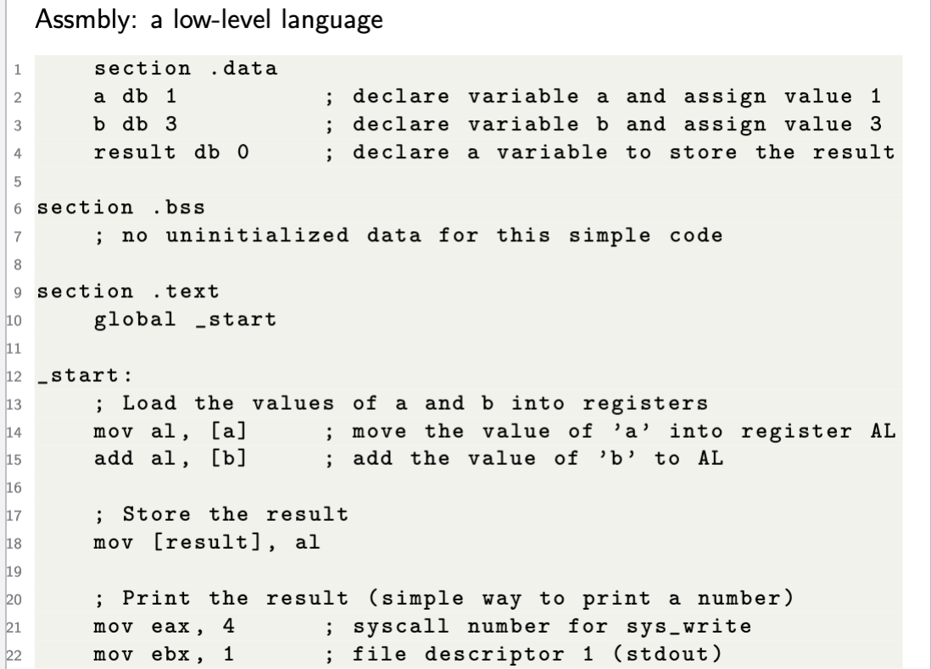
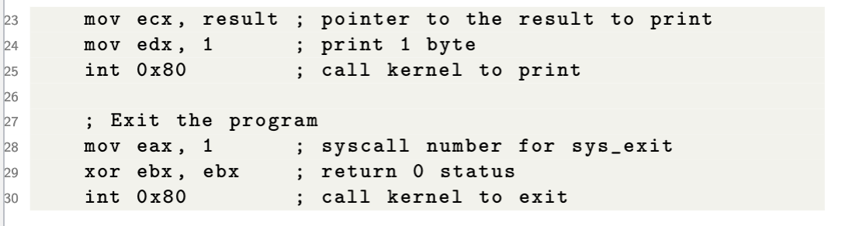

Slide 25
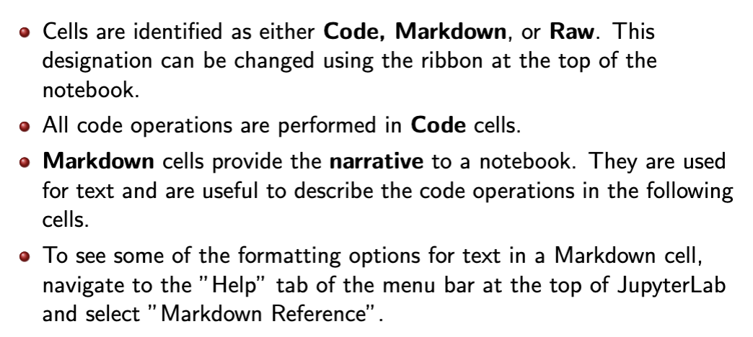
Jupyter Notebook

Slide 26
Thursday (No Class)
Homework 1:
https://canvas.wisc.edu/courses/450492/assignments/2613328?module_item_id=8215372
Due by Jan 28 11:59 PM Central Time

Slide 27
Thanks!
Questions?

Slide 28
SQL Overview
Standalone SQL Server:
Involves local installations, with the user directly managing the server.
Best suited for applications where individual users require full control.
Installation:
SQL Server 2022 Express is a free edition of SQL Server, ideal for development and production for desktop, web, and small server applications.
Download (Express): https://www.microsoft.com/en-us/sql-server/sql-server-downloads
Cloud-based SQL Server:
Enhanced for Team Collaboration and Integration:
Hosted on cloud platforms, facilitating easy access for multiple users.
Ideal for applications that demand collaboration across a team.
Supports Upstream & Downstream Applications:
Offers scalability, essential for evolving upstream and downstream applications.
Reduces the need for extensive physical infrastructure, enabling more efficient data flow and management in complex analysis.

Slide 29
Introduce Yourself and Your Course Expectations
Introduction: This assignment is not about right or wrong but is designed to help me get to know you better and tailor the course to support your development effectively.
1. In a brief introduction, please share what initially attracted you to the course.
2. Do you plan to enter the industry immediately after completing your undergraduate degree, or do you intend to pursue further education, such as graduate school, before entering the workforce? How can I better support you in achieving your career goals?
3. Are you currently seeking an internship? If so, in which field are you interested?
4. What specific knowledge or skills do you hope to gain by the end of the semester? Is there a particular topic, concept, or skill that excites you and that you aim to explore or improve upon during this course? Please conclude by summarizing what you aspire to achieve through this course and how it aligns with your broader educational and career journey.
Note: Your responses are confidential and will assist in customizing the course to meet your needs effectively.

Slide 30








A Modern Analytics Ecosystem
Data Sources
Modeling
FEDS Data Warehouse
Applications
Web-based Applications
The Food Dollar: Natural Resources Module Web Application
Farm-to-hub Flow Chart
Trade Chart
Water Use Maps
Online-reporting System
Modeling
FEDS Database
Cloud-based SQL server
Data Query Tools
Web Tools (online download)
SQL Query
Data Query through Excel, R, Python, Matlab, etc.
Box/Dropbox folders
Datasets are automatically or manually updated by scheduled ETL jobs.
Research
The Overlooked Magnitude of Post-Farmgate Food Value Chains
Python, GAMS, SAS, etc., scripts are used in the extraction, transformation, and loading process.
Documentations
Online data catalog
documentation
SQL lookup tables
…

